Slide 1

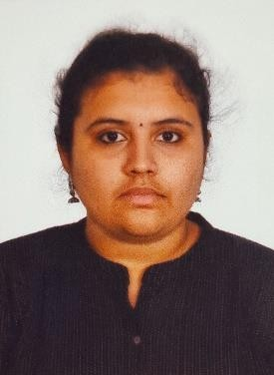


Shama Medam
Data Engineer Analyst
Email: shama.medam@accenture.com Mobile:+91 8015282408
Relevant Experience
GIC SYNERGY:
Role : Application Developer (Top Performer)
Experience : 1.5 Years
Worked on Enhancing several sub domains of the GEMS application
SDLC – Developing primarily in PL/SQL, Java classes
Sometimes enhancement in XML and Angular
Windows and Unix servers – for connectivity from PL/SQL or Java code to Jobs
Control M – Job management
Git , Jira
Background
GIC ALLEGRO:
Application Developer Analyst with 1.5 years of programming experience as an Oracle PL/SQL and Java Developer who was involved in all phases of the SDLC (Software Development Life Cycle) from analysis, design, development, SIT and UAT.
Role : Business Analyst
Experience : 6 Months
Worked on Developing Feedprocs for Master Data Management
Requirement Analysis
Data Preprocessing
Data Transformation
Feedproc creation for ETL
Have good experienced in client handling, requirement
gathering
and business user meeting.
OTHERS:
Business Analyst with 8 months of experience in Machine Learning and Deep Learning which involved all phases of Data analysis, preprocessing, Model Building and Optimization.
Business Analyst
Experience : 6 Months (Final Year Internship)
Worked in Business Intelligence Project
Data Analysis - SSAS, Talend
Data Preprocessing and Integration– SSIS, Talend
Report generation - SSRS, Power Bi, Tableau
Currently doing Master in Artificial Intelligence and Machine Learning in Bits Pilani (Distance Learning)
Machine Learning and Deep learning
Experience : 8 Months (Internship)
Worked as ML Engineer
Relevant Expertise:
Industry Expertise:
PL/SQL
Java
ML
DL
Python
Public market
Applications
Ml and DL models
Data Analysis – best suited algorithm
Data Preprocessing - Numpy, pandas
Data Visualization – seaborn, matplotlib, sklearn
Model building
Accuracy and optimaizartion
Front end – Flask and python

